Slide 1

WEB WRITING · UNIT PRESENTATION
Writing for the Web
Planning, organizing, designing, and writing content that works for online readers
Team Leader
Manila Aryal
Team Members
Alisha Manandhar · Ashlesha Shrestha · Diya Gartaula
8/12/2026

Slide 2
AGENDA
What we'll cover
01
02
03
04
Introduction
Organizing a Web Page
Writing Text for the Web
Special Web Pages
What web writing means and why it differs from print
Planning, structuring, and designing content for the screen
Titles, audience, structure, and scannable writing techniques
Home pages, blogs, FAQs, wikis, and discussion forums
WRITING FOR THE WEB
2

Slide 3

INTRODUCTION
Introduction to Writing for the Web
Writing for the Web means creating content for online readers.
Web readers usually scan content instead of reading every word.
Web content should be clear, concise, and easy to understand.
It should provide information quickly and effectively.
Good web writing focuses on the audience, purpose, and readability.
WRITING FOR THE WEB
INTRODUCTION
3

Slide 4
GETTING STARTED
Getting Started on Web Pages
Before creating a web page, a writer should:
Identify the audience – Know who will read the page.
Determine the purpose – Know what the page should achieve.
Select the topic – Choose a clear and relevant subject.
Gather information – Collect useful and accurate content.
Plan the content – Organize ideas before starting to write.
WRITING FOR THE WEB
GETTING STARTED
4

Slide 5
PLANNING
Planning the Web Page
A writer should consider:
What information does the reader need?
What is the main message?
How should the information be organized?
What headings and sections are needed?
What images, links, or other elements can support the content?
How can the page be made simple and easy to navigate?
Goal: Make the right information easy for the right audience to find.
WRITING FOR THE WEB
PLANNING
5

Slide 6
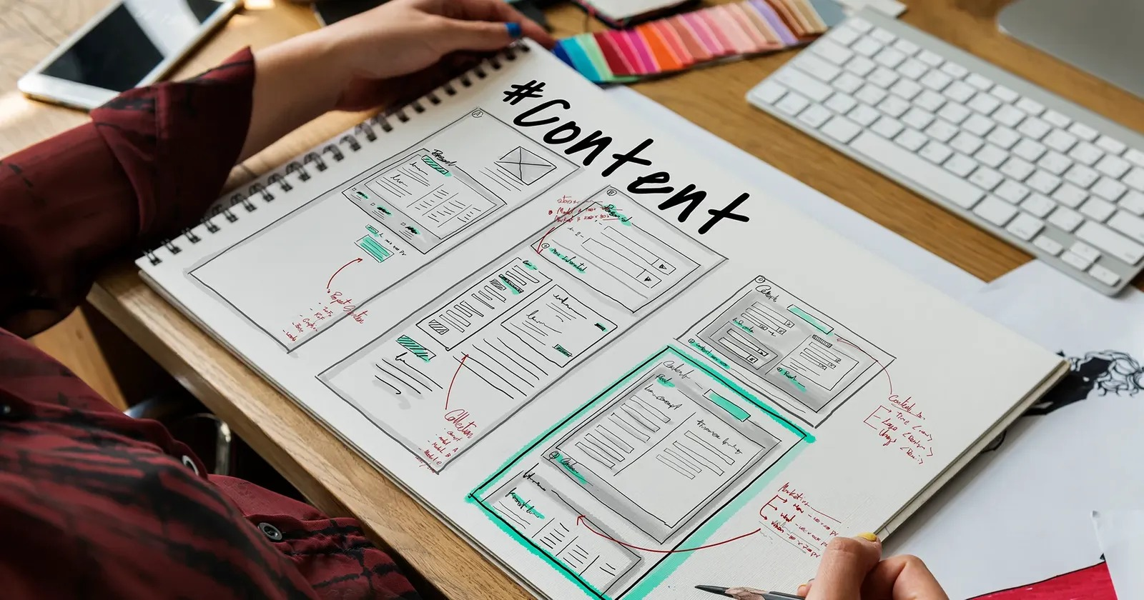
ORGANIZING A WEB PAGE
Organizing Web Pages
Organizing web pages means arranging website content in a clear and logical structure so users can easily find information.
📝 List Content – Identify everything that needs to be included.
📂 Group Information – Organize related items into categories or topics.
⭐ Set Priorities – Arrange content according to its importance to users.
🗂️ Create a Structure – Decide how pages and sections will be connected.
🔗 Use Hyperlinks – Connect pages, sections, or external sites for easy navigation.
WRITING FOR THE WEB
ORGANIZING A WEB PAGE
6

Slide 7

DESIGNING A WEB PAGE
Designing a Web Page
DEFINITION
Web page designing is the process of planning, creating, and arranging the content and visual elements of a webpage to make it attractive, functional, user-friendly, and easy to navigate.
WRITING FOR THE WEB
DESIGNING A WEB PAGE
7

Slide 8
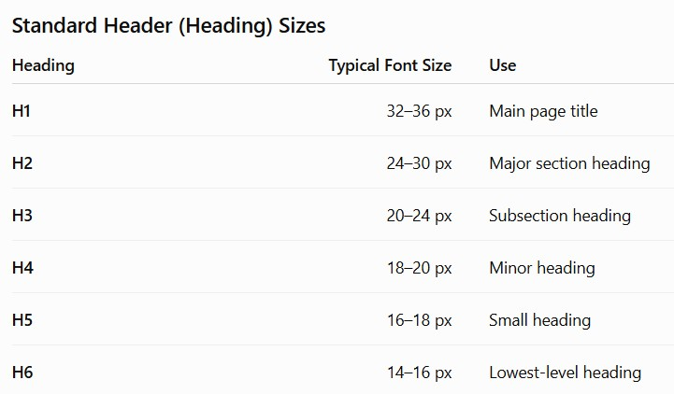
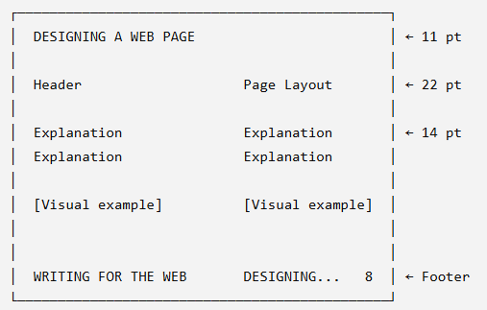
DESIGNING A WEB PAGE
Header
Page Layout
Acts as the top section or virtual storefront of a webpage.
Usually contains the logo, title, navigation bar, and menu.
Helps users quickly identify and navigate the website.
Headings commonly use sizes H1–H6.
Refers to the arrangement of text, images, menus, header, sidebar, and footer.
Organizes content logically for tidiness and easy navigation.
Shows structure and placement of different elements.
Important elements (title, purpose, nav) should be placed near the top.
WRITING FOR THE WEB
DESIGNING A WEB PAGE
8

Slide 9
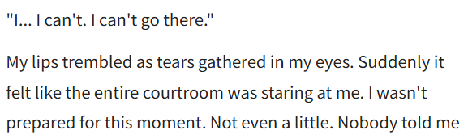



DESIGNING A WEB PAGE
Line Length
Graphics
Refers to the number of characters or words per line.
Shorter lines improve readability and reduce eye movement.
Standard – 50–70 characters or 10–12 words per line.
Includes images, icons, logos, charts, and illustrations.
Breaks up text and attracts attention.
Should be relevant and optimized for faster loading.
Common formats – JPEG, GIF, and PNG.
WRITING FOR THE WEB
DESIGNING A WEB PAGE
9

Slide 10
DESIGNING A WEB PAGE
Multimedia
Tables
Includes animation, audio, video, and interactive elements.
Makes content more engaging and informative.
Should be used carefully to avoid distraction and slow loading.
Organize text and graphics clearly.
Make information easier to compare and understand.
Invisible tables can be used to create the basic structure of a webpage.
WRITING FOR THE WEB
DESIGNING A WEB PAGE
10

Slide 11
DESIGNING A WEB PAGE
Borders
Font
Lines around text, images, tables, or sections.
Separate and organize content.
Should be used properly to avoid a cluttered appearance.
Determines the style, size, and appearance of text.
Clear and simple fonts improve readability and professionalism.
Avoid excessive CAPITAL LETTERS and bold text, as they can appear like shouting.
Aa
Aa
WRITING FOR THE WEB
DESIGNING A WEB PAGE
11

Slide 12
DESIGNING A WEB PAGE
Colors
Accessibility
Make webpages attractive and readable.
Choose colors based on the purpose and target audience.
Use proper color combinations and contrast between text and background.
Means designing webpages that can be used by everyone, including people with disabilities.
Use readable fonts and good color contrast.
Provide alternative text (alt text) for images.
Provide captions for audio and video content.
WRITING FOR THE WEB
DESIGNING A WEB PAGE
12

Slide 13
DESIGNING A WEB PAGE
Consistency
Means keeping layout, fonts, colors, buttons, navigation, and formatting consistent.
Creates a professional and organized appearance.
Improves website readability and navigation.
Provides a better and more comfortable user experience.
INCONSISTENT
CONSISTENT
WRITING FOR THE WEB
DESIGNING A WEB PAGE
13

Slide 14

WRITING TEXT FOR THE WEB
Writing Text for the Web
WRITING FOR THE WEB
WRITING TEXT FOR THE WEB
14

Slide 15
WRITING TEXT FOR THE WEB
Page Title
A page title tells users what a webpage is about. A good page title should be:
Clear and descriptive
Short and specific
Relevant to the content
Attractive to readers
Include important keywords when appropriate to the content
Example
❌ Welcome to Our Website
✅ BSc CSIT Course Information
WRITING FOR THE WEB
WRITING TEXT FOR THE WEB
15

Slide 16

WRITING TEXT FOR THE WEB
Audience
The audience is the group of people who will read or use the webpage. A writer should consider:
Who are the readers?
What do they already know?
What information do they need?
What language will they understand?
Example
A website for beginners → simple language
A website for experts → technical terminology
WRITING FOR THE WEB
WRITING TEXT FOR THE WEB
16

Slide 17
WRITING TEXT FOR THE WEB
Inverted Pyramid
The inverted pyramid means putting the most important information first, followed by supporting details. This is important because web users may leave a page without reading everything.
The most important info: who, what, when, where, why, how
Additional details, important and unique
Example
Exam results will be published on August 15. Students can check their results through the college website. Further instructions will be provided later.
Details that add value, if the reader wants to know more
WRITING FOR THE WEB
WRITING TEXT FOR THE WEB
17

Slide 18
WRITING TEXT FOR THE WEB
Facts, Not Hype
Web content should provide facts and useful information, rather than exaggerated or promotional claims.
Do
Don't
Use accurate information
Give evidence where necessary
Be objective
Avoid exaggeration
Make unsupported claims
Use excessive promotional language
Mislead the audience
Example
❌ We provide the world's best computer course!
✅ Our course covers programming, databases, networking, and web development.
WRITING FOR THE WEB
WRITING TEXT FOR THE WEB
18

Slide 19
WRITING TEXT FOR THE WEB
Scannable Text
Scannable text allows readers to quickly look through a webpage and find what they need. Readers usually scan a webpage before deciding what to read.
Use short paragraphs
Use headings
Use bullet points
Highlight important words
Use simple sentences
19

Slide 20
WRITING TEXT FOR THE WEB
Headings
Headings and subheadings divide content into smaller sections. They help readers:
Understand the structure
Find information quickly
Scan the page easily
Know what each section contains
Example
Course Information
Admission Requirements
Course Structure
Fee Structure
WRITING FOR THE WEB
WRITING TEXT FOR THE WEB
20

Slide 21
WRITING TEXT FOR THE WEB
Paragraphs to Lists
Long paragraphs can be difficult to read on a screen. Convert information into bullets or numbered lists whenever appropriate.
PARAGRAPH
REQUIRED DOCUMENTS
Students need to submit their application form, citizenship certificate, academic certificates, photographs, and application fee.
Application form
Citizenship certificate
Academic certificates
Photographs
Application fee
Result: The information becomes easier to scan and understand.
WRITING FOR THE WEB
WRITING TEXT FOR THE WEB
21

Slide 22
WRITING TEXT FOR THE WEB
Keywords
Keywords are important words or phrases related to the main topic of a webpage. They help in:
Readers understand the topic
Search engines identify the content
Users find relevant information
Example
For a webpage about Python:
Keywords:
Python programming, Python tutorial, learn Python, Python course
WRITING FOR THE WEB
WRITING TEXT FOR THE WEB
22

Slide 23

SPECIAL WEB PAGES
Special Web Pages
DEFINITION
Special web pages are webpages created for a specific purpose, such as providing information, answering questions, sharing ideas, or enabling discussions among users.
TYPES OF SPECIAL WEB PAGES
Home pages
Blogs
FAQ (Frequently Asked Questions)
Wiki
Discussion Forums
WRITING FOR THE WEB
SPECIAL WEB PAGES
23

Slide 24
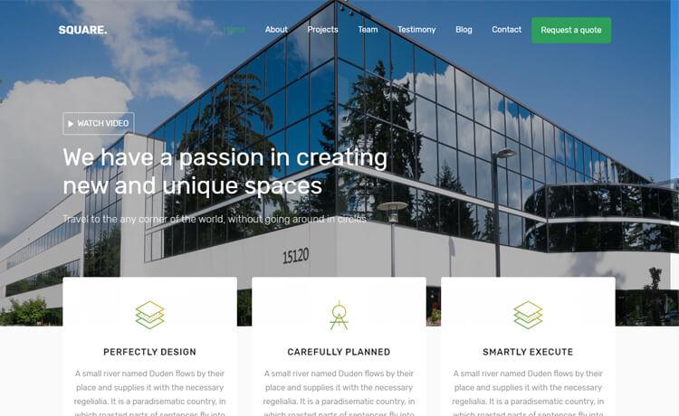
SPECIAL WEB PAGES
Home Page
DEFINITION
Acts as the entry point to a website and provides links to other pages.
FEATURES
First page visitors see
Contains a navigation menu
Gives an overview of the website
May include a search bar, images, and announcements
WRITING FOR THE WEB
SPECIAL WEB PAGES
24

Slide 25
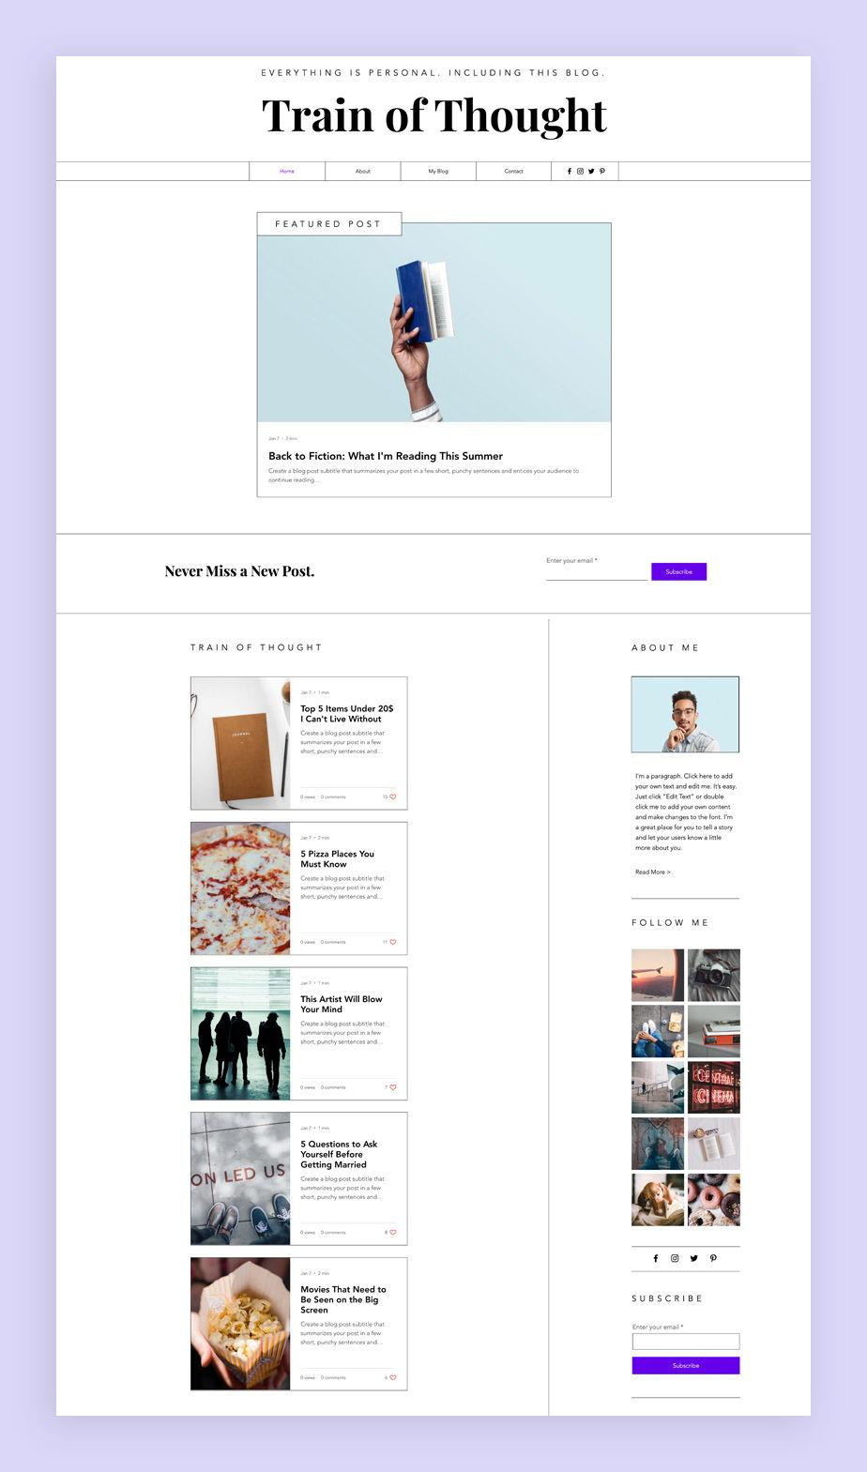
SPECIAL WEB PAGES
Blogs
DEFINITION
A website or webpage where articles or posts are published regularly in chronological order.
FEATURES
Regularly updated
Posts displayed from newest to oldest
Can include multiple media (text, images, videos)
Examples: Personal blogs, technology blogs, travel blogs
WRITING FOR THE WEB
SPECIAL WEB PAGES
25

Slide 26
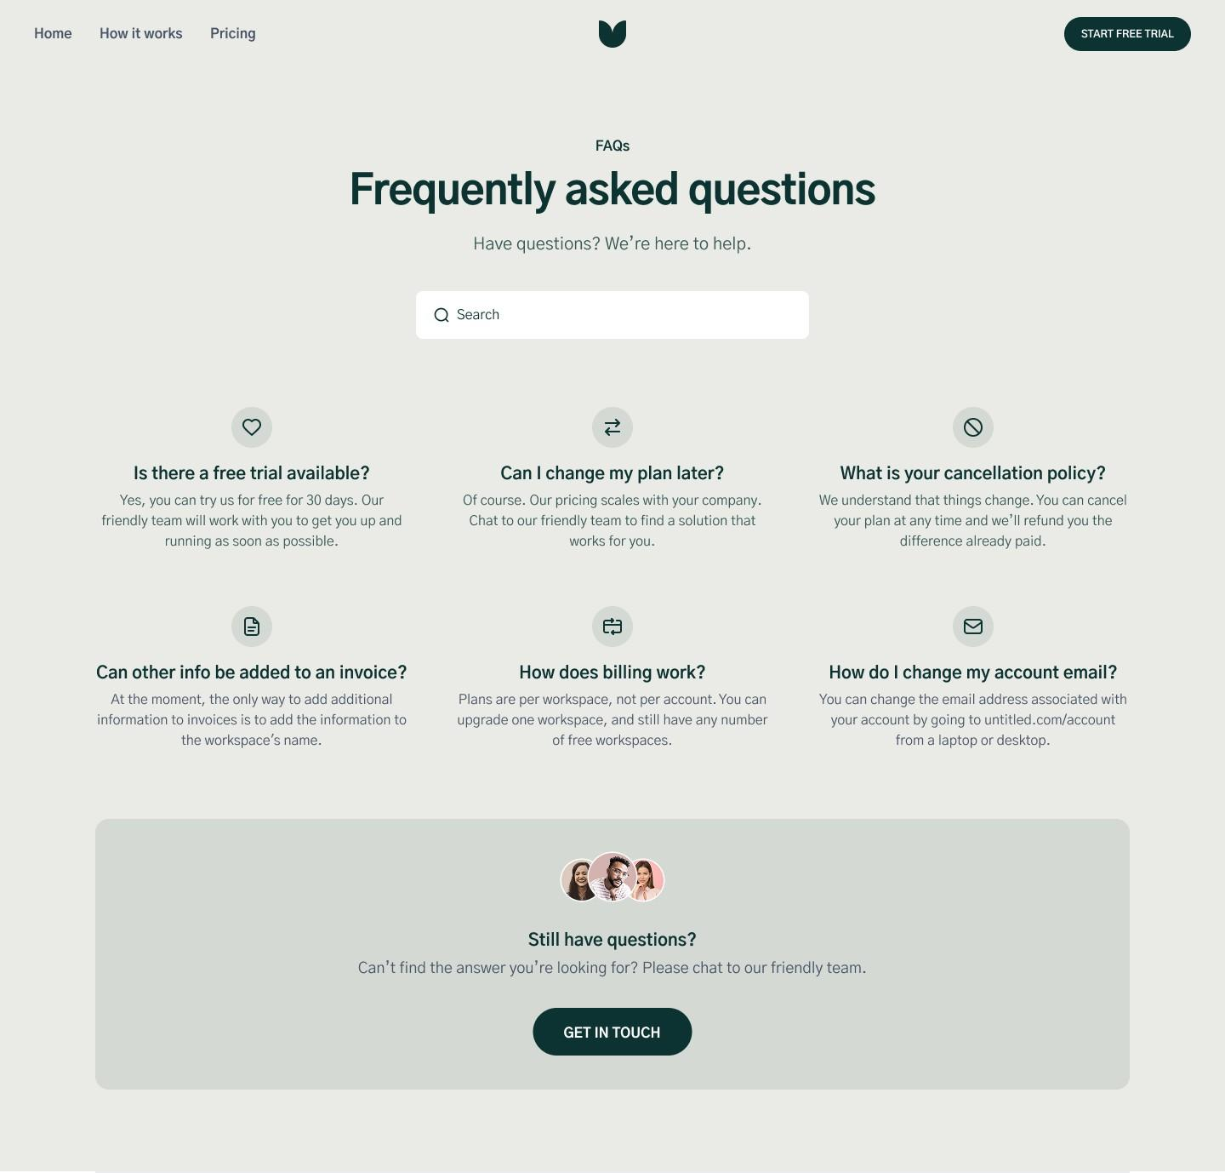
SPECIAL WEB PAGES
FAQ (Frequently Asked Questions)
WRITING FOR THE WEB
SPECIAL WEB PAGES
26

Slide 27
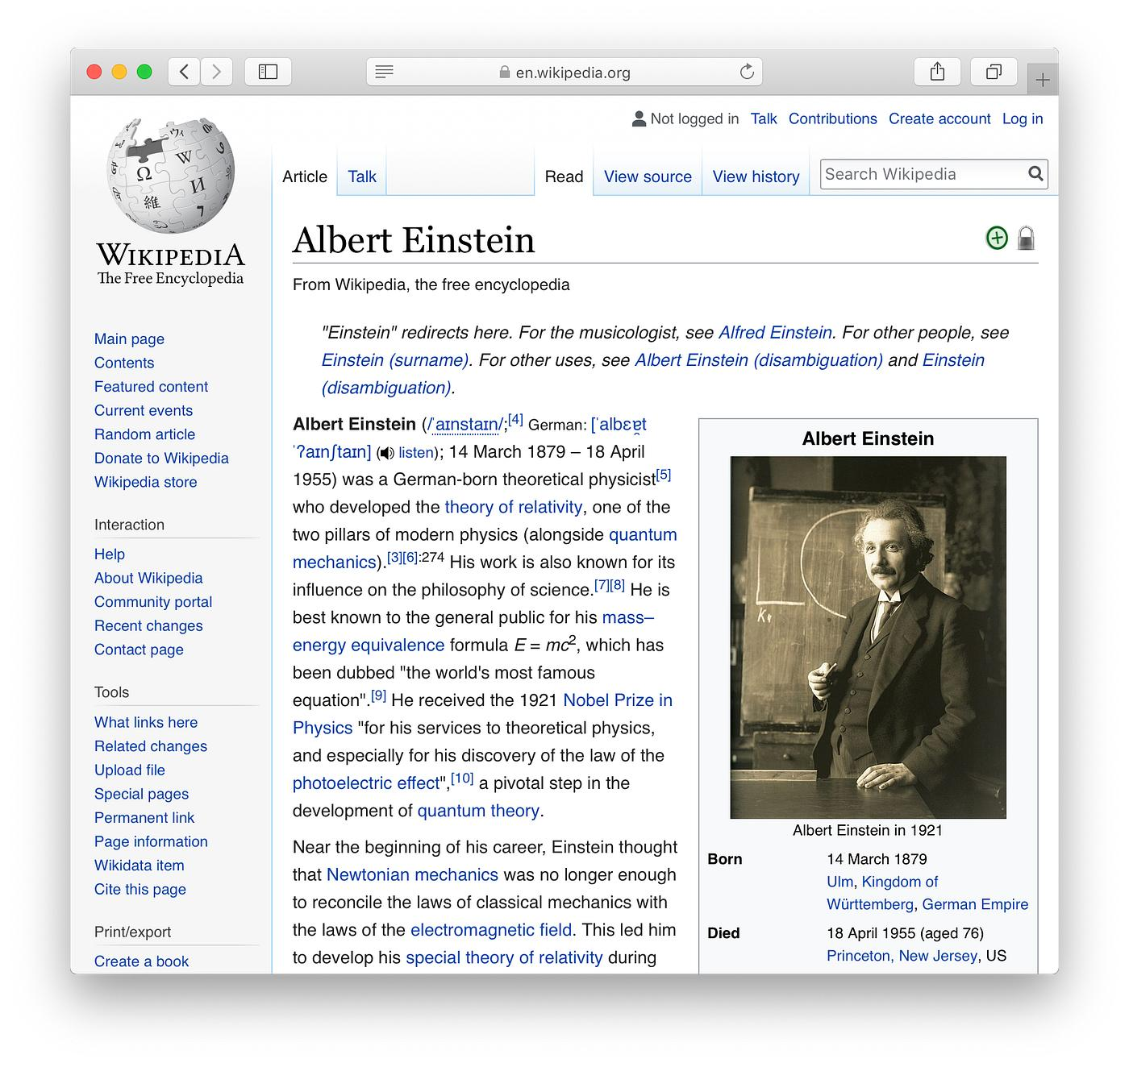
SPECIAL WEB PAGES
Wiki
DEFINITION
A wiki is a website where multiple users can create, edit, and update content collaboratively.
FEATURES
Anyone with permission can edit
Static in nature
Information is continuously updated
Links between related topics
WRITING FOR THE WEB
SPECIAL WEB PAGES
27

Slide 28
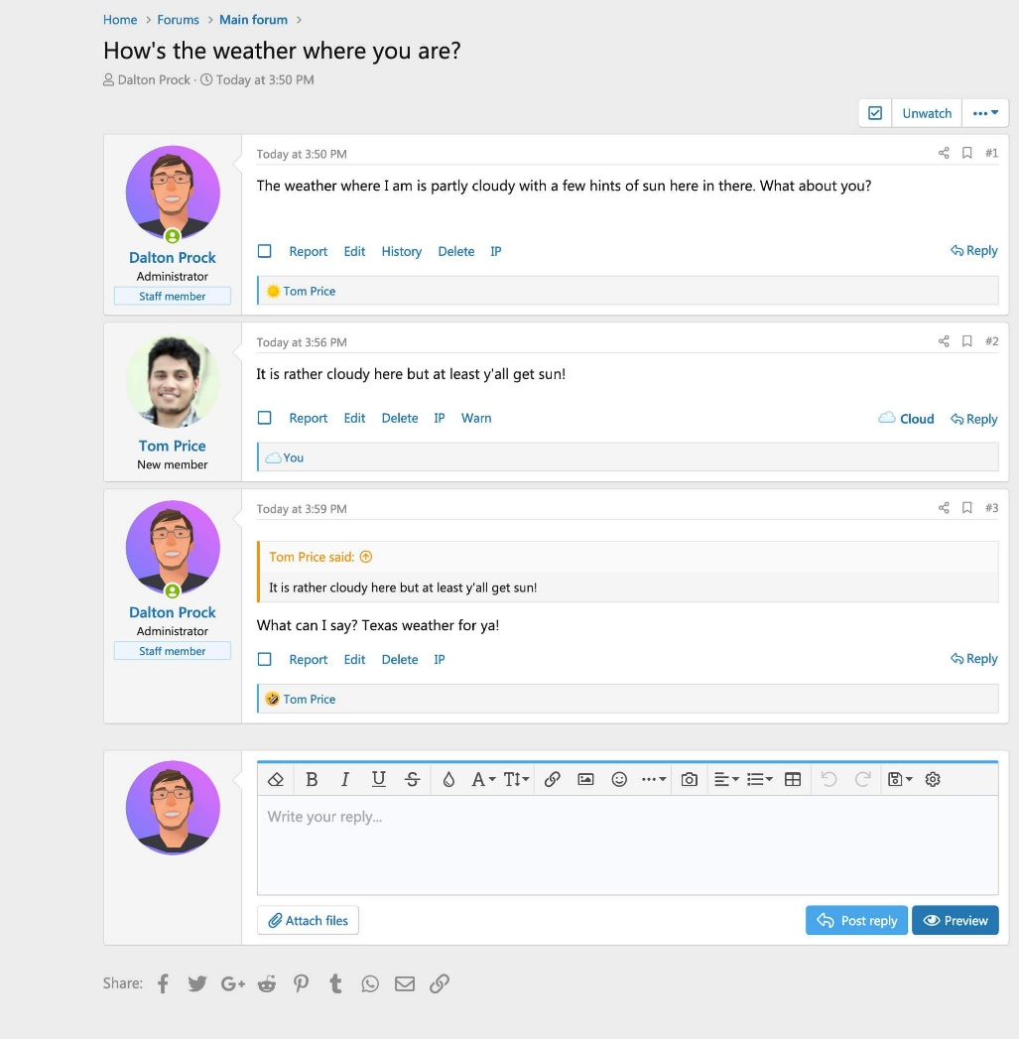
SPECIAL WEB PAGES
Discussion Forums
DEFINITION
A discussion forum is an online platform where users ask questions, share ideas, and discuss topics by posting messages.
FEATURES
Questions and replies
Topic-wise discussions
Community participation
Examples: Reddit, Quora, Stack Overflow, college discussion forums
WRITING FOR THE WEB
SPECIAL WEB PAGES
28

Slide 29
SUMMARY
Writing for the Web — Key Takeaways
Web writing is designed for online audiences, not print readers.
Effective web content is clear, concise, accurate, and organized.
Understand your audience and purpose before creating a page.
Plan pages around what the reader actually needs to find.
Good organization makes content easier to locate and understand.
“Good web writing makes information simple, useful, and accessible.”
Thank you

